Slide 1
ESQC 2026
Mathematical Methods
Lecture 1
By Simen Kvaal

Slide 2

Material for mathematics course
Lecture notes
Exercise book
Roadmap
Slides
Where to find it:
  https://simenkva.github.io/esqc_math

Slide 3
Introduction

Slide 4

Why learn mathematics?
Quantum chemistry requires mathematics
From applications of DFT …
… to invention of new methods
Mathematics is the language of science
Mathematics is fun and useful

Slide 5
Mathematics, you see, is not a spectator sport. To understand mathematics means to be able to do mathematics.
(From “How To Solve It”)
George Pólya (1887–1985)
Hungarian-American mathematician

Slide 6
Mathematics at ESQC
One cannot teach mathematics in 5 hours
  We can give an overview
  Inspiration
One cannot learn mathematics in 5 hours
  Soak up the inspiration!
  Do not despair – exercise!
Exercises:
  The math exercises are today!
  Exercises focus on important topics

Slide 7
Real and complex numbers
What we work with every day

Slide 8

Natural numbers
Notes:
\mathbb{N} = \{0, 1, 2, 3, \ldots \}

Slide 9
Integers
First occurs in Chinese mathematics <300 AD (Han Period or before)
Called “absurd numbers” in Europe until 16th century!
In Europe, first satisfactory account by Cardano (1545)
Notes:
\mathbb{C} = \{ \; x + \mathrm{i} b \;\mid\; a,\, b \in \mathbb{R}\; \}, \qquad \mathrm{i}^2 = -1

Slide 10
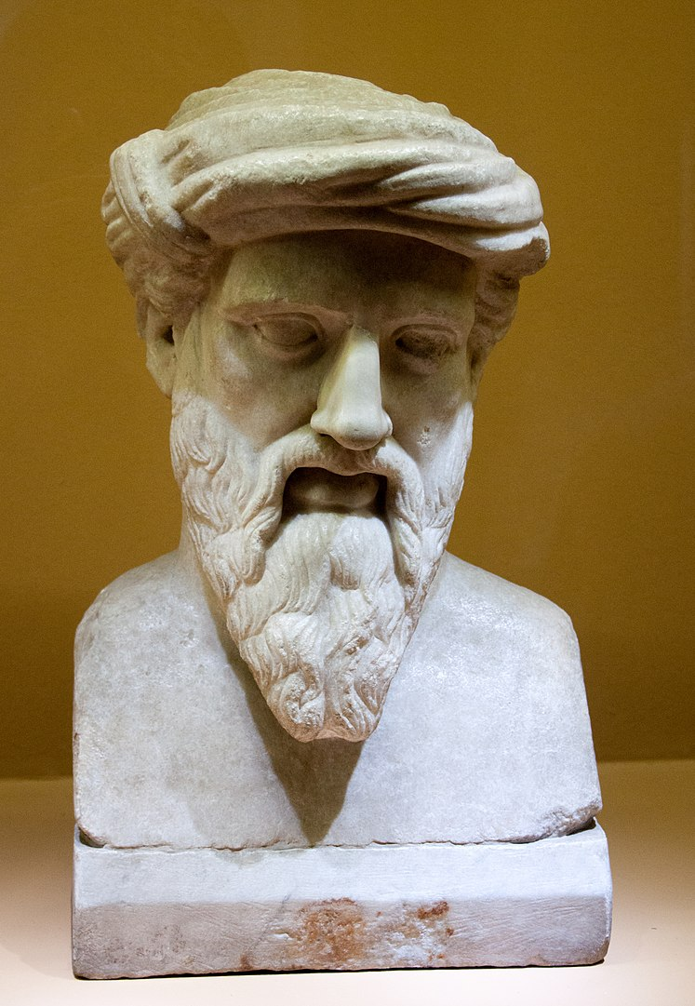
Rational numbers
Pythagoras of Samos
To the Pythagorean school, ”everything is number”. And by number, they meant rational number.

Slide 11
Real numbers
The real numbers form a complete ordered field:
Field: Closed under addition and multiplication, and
every number except 0 has a multiplicative inverse
Ordered: We always have a ⩽ b or b ⩽ a
Completeness: Cauchy sequences converge to numbers in ℝ

Slide 12
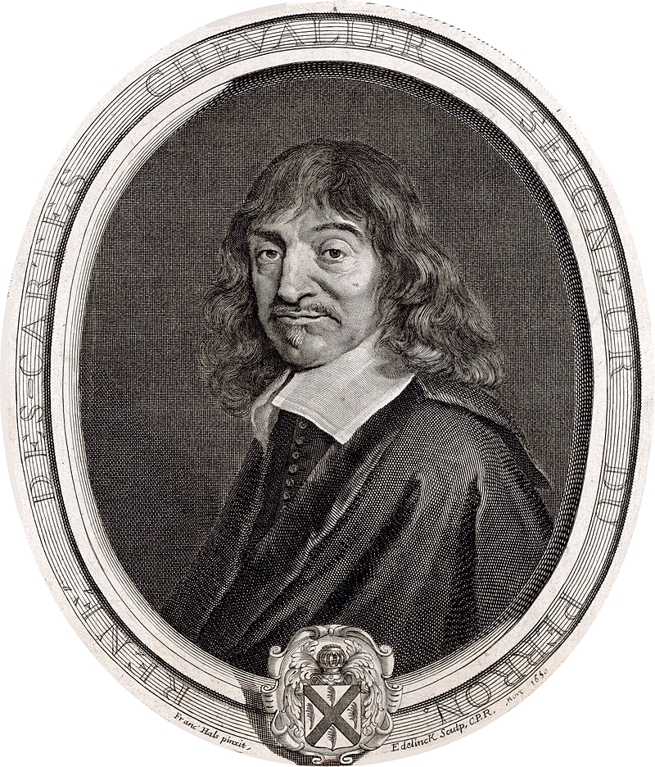
Complex numbers
These numbers have no use, they are imaginary
An algebraic extension of reals
For z = x + i y :
René Descartes (1596–1650)
Notes:
\mathbb{C} = \{ \; x + \mathrm{i} b \;\mid\; a,\, b \in \mathbb{R}\; \}, \qquad \mathrm{i}^2 = -1

Slide 13
Geometric interpretation
Discovered by the Norwegian mathematician and cartographer Caspar Wessel (1797)
Multiplication rule:

Slide 14
Fundamental theorem of algebra
The complex numbers are a field like the reals, but we can «do more stuff» with complex numbers

Slide 15
An introduction to linear algebra
Perhaps the most important mathematical tool in science
Notes:
ø

Slide 16
1. Liner algebra in 2D

Slide 17
Points in the plane
We start by considering points in the plane
We can add two points
We can also scale a point

Slide 18
Points as arrows: Vectors
We visualize a point as an arrow from the origin
Adding and scaling become geometric operations
Points/vectors in the plane form
a 2D vector space:

Slide 19
Inner product and norm
Every arrow has a length: norm
Two arrows span an angle
Norm and angle comes from Euclidean inner product
We obtain a Hilbert space
Demo: lecture-1-plane-geometry.ipynb

Slide 20
Linear transformations in the plane
An important class of transformations is linear transformations
Intuition: straight lines go to straight lines (or to points)
Computational machinery: matrix algebra
Demo: lecture-1-plane-transformation.ipynb
Example of matrix vector product
Notes:
(

Slide 21
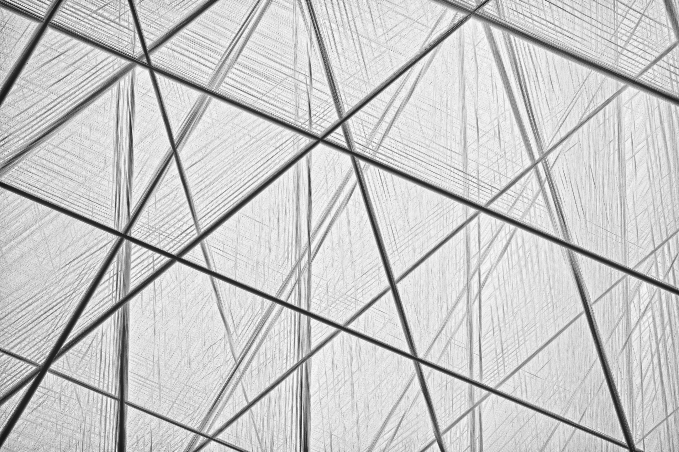
Linear transformations are extremely important in quantum chemistry

Slide 22
The standard basis
A basis is a set of vectors in which all vectors can be expanded
Here is the standard basis:
There are infinitely many bases!

Slide 23
Other bases
Example:
Othonormal bases have orthogonal vectors that have unit norm:

Slide 24
Eigenvalue problem
Eigenvalue
Given a matrix A, an important problem is:
Find x and 𝜆 such that:
Interpretation: The action of an otherwise stretching, rotating, reflecting operation - on x it is just a scaling
Sometimes, one can find a basis of eigenvectors
  We like this because in a basis of eigenvectors A is really simple!
Eigenvector

Slide 25
2. Higher dimensions

Slide 26
Higher dimensions
Nothing special about 2 dimensions (easy to visualize, though)
Vectors in any dimension are defined similarly
Complex vectors are also common
Notes:
Northin

Slide 27
Basis in higher dimensions
A basis in n dimensions:
Can expand any vector:
An orthonormal basis is an n-dimensional axis cross:

Slide 28
Linear transformations in higher dimensions
A linear transformation is a function between vector spaces:
Linear transformations preserve scalar multiplication and addition:
Essentially the same as in 2D - just harder to visualize

Slide 29
Demo: blurring an image
We show an example of a linear transformation
Very high dimension, yet visual ...
Demo: lecture-1-blurring.ipynb

Slide 30
Matrices
A matrix is a table of numbers
Vectors are also matrices!
# cols
# rows
Notes:
A \in \mathbb{F}^{m \times n} = M(m,n;\mathbb{F})

Slide 31

The matrix-vector product
A matrix and a vector can be multiplied together
Notes:
A(\mathbf{x})_i = \sum_{j=1}^n A_{ij} x_j
A = \begin{bmatrix} A_{11} & A_{12} & \cdots & A_{1n} \\
A_{21} & A_{22} & \cdots & A_{2n} \\
\vdots & \vdots & \ddots & \vdots \\
A_{m1} & A_{m2} & \cdots & A_{mn} \end{bmatrix}

Slide 32
Matrices = linear transformations
The matrix-vector product is linear
Therefore it defines a linear transformation (from n to m dimensions)
Conversely, any linear transformation can be written as a matrix-vector product
A powerful result!
Notes:
A matrMatriu

Slide 33
Matrix-matrix product
Suppose we have two matrices A and B
Leads to matrix-matrix product C = AB

Slide 34


Computing the matrix product
Note: A ⨉ a column of B = a column of C
Notes:
\begin{bmatrix} A_{11} & A_{12} & \cdots & A_{1n} \\
A_{21} & A_{22} & \cdots & A_{2n} \\
\vdots & \vdots & \ddots & \vdots \\
A_{m1} & A_{m2} & \cdots & A_{mn} \end{bmatrix} \begin{bmatrix} B_{11} & B_{12} & \cdots & B_{1o} \\
B_{21} & B_{22} & \cdots & B_{2o} \\
\vdots & \vdots & \ddots & \vdots \\
B_{n1} & B_{n2} & \cdots & B_{no} \end{bmatrix} = \begin{bmatrix} C_{11} & C_{12} & \cdots & C_{1o} \\
C_{21} & C_{22} & \cdots & C_{2o} \\
\vdots & \vdots & \ddots & \vdots \\
C_{m1} & C_{m2} & \cdots & C_{mo} \end{bmatrix}

Slide 35
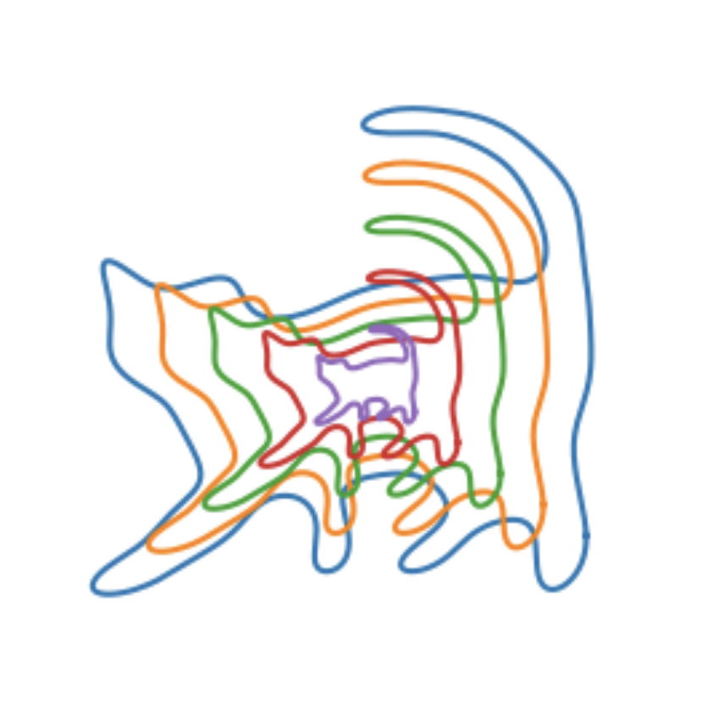
Eamples of linear transformations in 2D
Demo: lecture 1 – transforming a cat.ipynb

Slide 36
Matrix multiplication is not commutative
When multiplying real or complex numbers:
When multiplying matrices:
Scalar multiplication is «commutative»
Matrix multiplication is «non- commutative»

Slide 37
Example

Slide 38
Matrices transform between vector spaces
A matrix transforms from n to m dimensions:

Slide 39
General matrix product
Composition of linear transformatons are linear → matrix-matrix product

Slide 40
End of lecture 1
That’s it for today!
Tutorial:
  Bring laptop or mobile device to read the exercise book
  Additional content for other tutorials the rest of the week: optional math exercises

